Slide 1
Linux schedule
Dong Shaojie
2019

Slide 2
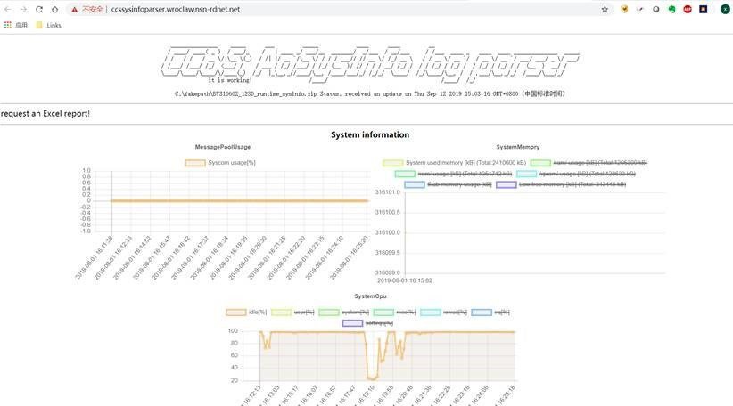
http://ccssysinfoparser.wroclaw.nsn-rdnet.net/
Focus on
IDLE
RT process
Normal process

Slide 3
Idle process pid zero
/sbin/init -> /lib/systemd/systemd
用户态大哥
assembly
start_kernel
rest_init
创建1号内核线程
/sbin/init
创建2号内核线程
Kthreadd 内核态大哥
无中生有0号进程
cpu_startup_entry
cpu_idle_loop
assembly
secondary_start_kernel
cpu_startup_entry
cpu_idle_loop

Slide 4
Idle loop
cpu_idle_loop
while(1)
Task
while(!need_resched())
Cpu low power mode
Task
schedule()

Slide 5
Schedule queue
Core 0
Core 1
Task
Task
Each run task put itself to the queue and pop next task, then switch context
Run Queue
Run Queue
Wait Queue
Wait Queue
Task
Task
Task
Task
Task
Task
Task
Task
Task
Task
struct
double linked list

Slide 6
Run queue
CPU
With Priority
Stop class
DL class
RT class
CFS class
IDLE class

Slide 7
CPU
Run queue
Stop queue
Queue depth = 1 (pointer)
Number 1
Number 2
Number 3
Number 4
Number 5
DL queue
Queue depth = N (rb tree)
RT queue
Queue depth = 100 (array)
CFS queue
Queue depth = N (rb tree)
IDLE queue
Queue depth = 1 (pointer)

Slide 8
Depth 1 queue
Number 1
Yes/No
Stop Task
Stop queue
always
IDLE Task
Number 5
IDLE queue

Slide 9
RB tree queue
Number 2
DL queue
Early Deadline First
CPU
pop leftmost
Deadline more early

Slide 10
Array queue
array
linked list
RT queue
0
FIFO
RR
Number 3
1
Increase priority
2
3
FIFO
FIFO
CPU
…...
Pop first non-empty
99
RR
FIFO
Higher Priority
-20 Nice +19
RT
Normal
0 99 100 139

Slide 11
RT tree queue
Number 4
CFS queue
CPU
pop leftmost
Virtual runtime less
Higher Priority
-20 Nice +19
RT
Normal
0 99 100 139

Slide 12
RT task throttling
PC server:
/proc/sys/kernel/sched_rt_period_us 1000000
/proc/sys/kernel/sched_rt_runtime_us 950000
CPU
pop null
RT queue
Over time limit
Local board:
/proc/sys/kernel/sched_rt_period_us 1000000
/proc/sys/kernel/sched_rt_runtime_us -1

Slide 13
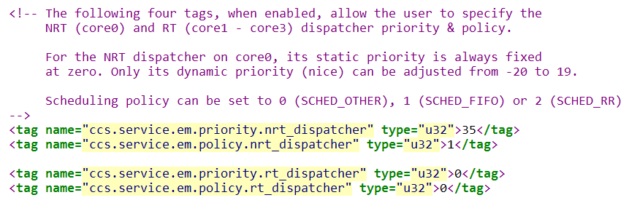
FSM4 config
/master/SCI_Interface_FSM4/C_Platform/CCS_RT/CCS_Daemon/cfg/K2_ARM_FSM4/Lte/RTCCSConfig.xml

Slide 14
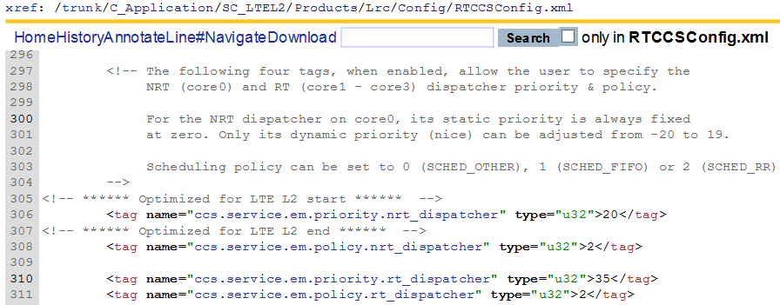
LRC config

Slide 15
Thank you ！

